Slide 1
Purchasing Procedures Training
2023-2024

Slide 2
Agenda
Finding Information and Who to Contact
Workday Training Information
Requisition Cut-off Dates
Governance, Statutory Requirements and Thresholds
Vendor Additions & Updates
SBITA
Quotes, Bidding, Specifications, Agreements & Evaluations
Cooperatives, Sole Source & Emergency Purchases
Open POs & Change Orders
Compliance
Special Contract Information
Free Tools
Closing Q&A

Slide 3
How do I find information about Purchasing?
Both Workday and the Intranet Pages can be accessed through CougarWeb and provide information from policies and procedures to Workday Guides and Staff Information.
Workday training materials, TIP Tuesday archive and list of Collin contracts available for use can be found here: https://inside.collin.edu/workday/purchasing.html
Contact the Staff person that is listed for the department or commodity on the Purchasing Intranet site.
(http://inside.collin.edu/purchasing/staff.html)
2

Slide 4
Who do I contact in Purchasing?
If related to a specific purchase, contact the buyer for that department or commodity listed on the Purchasing Intranet site or the buyer that placed the order.
To expedite a requisition in the Purchasing Approval queue, contact Tim Accountius, Karen Bell or Jennifer Wright if Tim and Karen are unavailable.
Workday Training or questions, contact Katherine Rios.

Slide 5
Who do I contact in Purchasing?
For review of an agreement not associated with a requisition, submit through OpenGov
Contact Katherine Rios to be invited to OpenGov
For vendors requesting a tax exempt form or requesting a credit application be filled out, contact Yvette Talley.
For access to Workday, contact Help Desk.
For purchases related to furniture and equipment for new campuses, contact Cindy White.

Slide 6
How do I access Workday training?
Training guides and videos are available through Cougarweb.
Click on Resources for Workday from the Home or My Workplace tab.
Select Purchasing from the navigation pane on the left.
You’ll find multiple guides and videos on how to use Workday for all of your purchasing related functions.
Questions about Workday purchasing should be directed to Katherine Rios.
Watch for TIP Tuesday emails from Katherine each week and if you are not receiving these you can ask her to add you to the distribution list. We’re still learning and these tips are how we’re keeping you informed of new functionality or recurring questions that arise.

Slide 7
Are there cut-off dates for requisitions?
What are the various requisition cut-off dates?
All furniture purchases must be submitted by April 15th
April 1st for purchases over $50,000 that require a bid or board approval
June 1st for purchases with long lead time
July 31st for all others
Must be delivered & received by August 31st
New Procurement Planning Guide included with handouts and will be added to the Purchasing Department Intranet page. Timelines are estimated as each purchase could have unique requirements. Get Purchasing involved early to avoid delays!!!
Please note, Board meetings are typically not held in July or November, plan accordingly! The December meeting is generally the first or second Tuesday of the month.

Slide 8
Purchasing Function Governance
Centralized Purchasing
Board Policy CF Local
Purchasing places all orders for all campuses, department & divisions, with few exceptions
All requests must be entered in Workday and routed through the approval path
Bid thresholds are determined by the entire District spend
Bid solicitations are done on behalf of the entire District

Slide 9
Purchasing Statutory Requirements
Texas Education Code 44.031
(a) Except as provided by this subchapter, all school district contracts for the purchase of goods and services, except contracts for the purchase of produce or vehicle fuel, valued at $50,000 or more in the aggregate for each 12-month period shall be made by the method, of the following methods, that provides the best value for the district:
(1) competitive bidding for services other than construction services;
(2) competitive sealed proposals for services other than construction services;
(3) a request for proposals, for services other than construction services;
(4) an interlocal contract;
(5) a method provided by Chapter 2269, Government Code, for construction services;
Government Code 2269 – Construction
Government Code 2254
Professional and Consulting Services

Slide 10
Purchasing Thresholds
Determined by total purchase, not line item
Less than $10,000 – one current price quote required from requesting department
$10,000 - $49,999 – Department or Purchasing obtains three (3) written price quotes
Allow Purchasing to obtain quotes for goods/services that are annual or involve several departments.
$50,000 and over – Purchasing solicits formal bids or proposals
legal notice requirements apply
All expenditures of $100,000 or more must have Board approval before a purchase order is processed
Board approval of the Budget does not mean that the Board has approved the purchase
Thresholds are determined by the aggregated amount spent within a fiscal year, District-wide
Purchase orders will not be processed until required quotes, bids, proposals, sole source documentation and approvals are received
Notes: Purchases for goods & services under contract or purchased through a cooperative only require one price, regardless of cost. Purchases with grant funds, even Innovation Challenge grant funds, are required to follow Purchasing Procedures. Purchases with Federal Grant funds are required to follow the most restrictive procedures.

Slide 11
Vendor Additions and Changes in Workday
Requests for new vendors and vendor changes must be submitted through Workday. Find instructions here: https://inside.collin.edu/workday/purchasing.html.
A W-9 and a Supplier Update form must be attached. Find form here: https://inside.collin.edu/purchasing/forms.html.
See the TIP Tuesday sent out on 11/28/2023 by Katherine Rios or find it in the TIP Tuesday archive here: https://inside.collin.edu/workday/purchasing.html.

Slide 12
Spend Categories for Subscription Based Information Technology Agreements (SBITA)
For subscription based software, use the spend categories below when submitting your requisition.
For questions, contact Jeanine Jones: 972.881.5701 or Keitha Carlton: 972.599.3103

Slide 13
GASB 96/Spend Category Decision Tree
Is the software cloud-based
No, use SC1079
Yes
Is the cost $100,000 or more (including this year and any optional renewals?
Yes
No, use SC1079
Is the agreement for less than 12 months (including any options to extend regardless of probability of renewal)?
If yes, use SC1079
No
Does the contract include a hardware component where the software component is insignificant? (i.e. copier lease)
If no, is the contract solely to provide IT support services?
Yes, use SC1079
Yes, use SC1230
If no, does the contract have a clause that it can be canceled at any time by both parties?
If no, use SC1229
If yes, use SC1079
Does it need to be set up as prepaid?
If the spend category is SC1229 you will not set it up as prepaid no matter the cost or crossing fiscal years.
If the spend category is SC1079, it crosses fiscal years, and the portion that will be in next fiscal year is $10,000 or greater it will need to be set up as prepaid. All three things must apply to require prepaid set up.

Slide 14
Requesting Quotes
When requesting quotes, whether written or verbal, requirements should be clearly communicated to the vendor(s).
Consistent requirements should be communicated to each vendor.
List all requirements for goods and services.
Shipping Terms
Location
Are there special needs?
Use of e-mail for obtaining quotes

Slide 15
Shipping Terms
F.O.B. (Free on Board) determines the point at which title or ownership transfers and responsibility for the goods while in transit.
F.O.B. Destination: Shipper maintains ownership and is responsible for the goods until received by the college at the destination indicated on the purchase order.
Any loss or damages would be handled by the shipper.
F.O.B. Origin: College takes ownership and responsibility once the goods leave the shippers location.
Any loss or damages would
be handled by the buyer.
Important to include shipping costs on the requisition and should be added in the Freight Amount field in the header, not as a line item.
Ask vendor to include shipping in their price or give a separate price.
Ideal shipping term is F.O.B. Destination, freight prepaid and allowed.
Shipper pays freight, owns goods in transit and files claims.

Slide 16
Electronic Bidding
Vendors self-register to receive solicitations in their respective fields
Vendors can view opportunities and respond online
System is used for formal, sealed solicitations, as well as informal quotes
Submitted responses are locked until the date and time of closing
System automatically tabulates responses and Vendors can view bid tabulations online
An active vendor in the bidding system does not mean they have been awarded a contract
Vendor Registration Link: https://procurement.opengov.com/signup

Slide 17
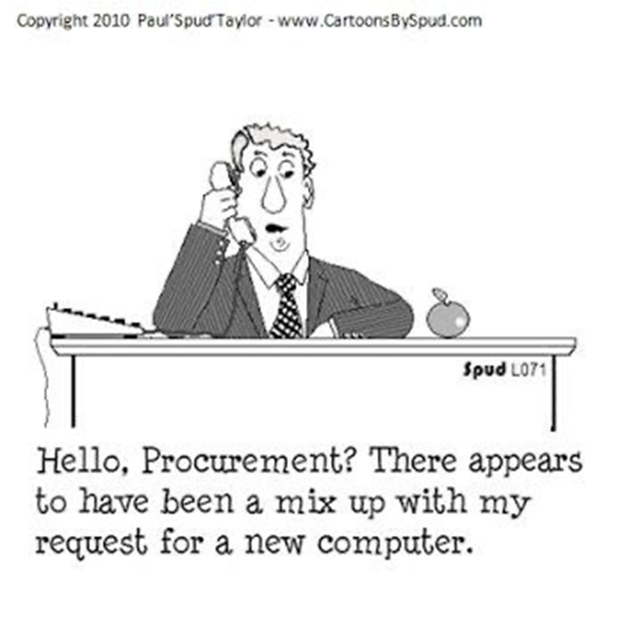
Provide Clear Requirements

Slide 18
Project Intake in OpenGov
Requests for issuing a solicitation or reviewing an agreement not associated with a requisition should be submitted using the Project Intake function in OpenGov.
To submit a request to be added to OpenGov go to https://procurement.opengov.com/signup. An administer on our team will approve.
Set up profile after approval.
Find instructions for submitting a project request: https://inside.collin.edu/purchasing/OpenGov%20Project%20Request.html.
Requests for rebid are sent through OpenGov now, so if you typically receive emails indicating that a contract is expiring and requires rebidding, you will now receive those as an email notification from OpenGov and will respond in OpenGov.

Slide 19
Signatory Authority
District President
Chief Financial Officer >$25,000
Executive Director Procurement Services <$25,000
These are the ONLY individuals, with a few exceptions, at the college that are authorized to sign contracts, agreements, or anything that obligates the college financially. See online chart for determining who needs to sign: http://inside.collin.edu/purchasing/Legal%20Review%20of%20Agreements.pdf.
Even though the agreement may not have a dollar value, there could be terms included that would obligate the college financially.
Contracts, agreements, etc. should be attached to the requisition, Purchasing will review and suggest any changes that need to be made and, once agreed to by vendor, will obtain signature.

Slide 20
Bid/RFP Specifications
The information that you provide on your requisition or specifications submitted through OpenGov will be used to create the solicitation
Information should be clear, concise and must not be restrictive
Having a vendor write bid specifications is considered a conflict of interest and that vendor will be prohibited from bidding
Vendors tend to write restrictive specifications that will prohibit other vendors or products from meeting the specifications
Things to consider when preparing specifications:
Timelines: When do you need it?
Issues that can affect timeliness of deliveries
Stock outs, backorders, supply chain issues
Economic, environmental or political issues
Time of year
Force Majeure
Where do the goods need to be delivered or services need to be performed?
Is there a specific room or location inside the building that the goods need to be delivered to?

Slide 21
Bid/RFP Specifications, cont.
Is there installation involved? If so, who is going to do the installation? Does the vendor provide installation?
Provide a specific or estimated quantity
Are licenses or certifications required?
Warranty, training, support
Who are the vendors that can provide the goods or service? Provide email if available.
What evaluation factors need to be considered?
Will there be any changes to the facility or anything related to the facility that will need to be considered?
Get Facilities and Construction involved early on.

Slide 22
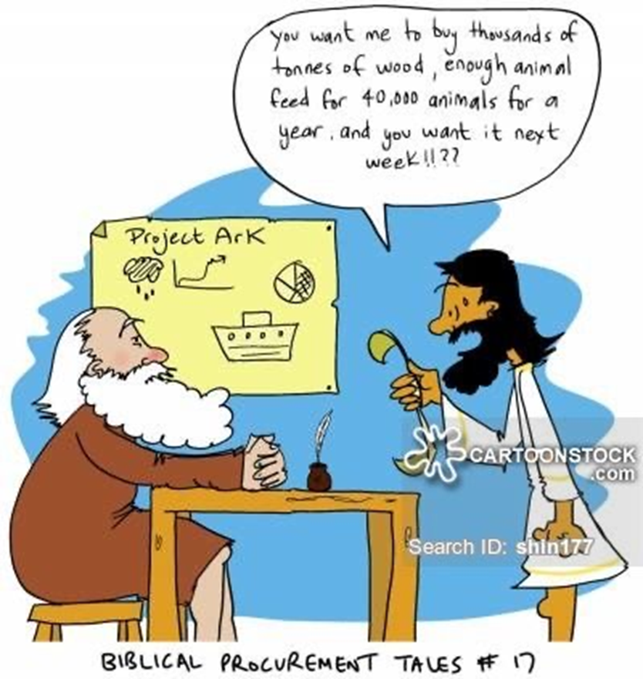
Plan Ahead!

Slide 23
Specification Resources
Need help writing your technical specifications?
OpenGov – Access to specifications from other agencies who use
Contact Purchasing for great specification resources
Contact other agencies that have purchased the same item or service
The earlier that you involve Purchasing in the process, the less likely you’ll be to encounter delays.

Slide 24
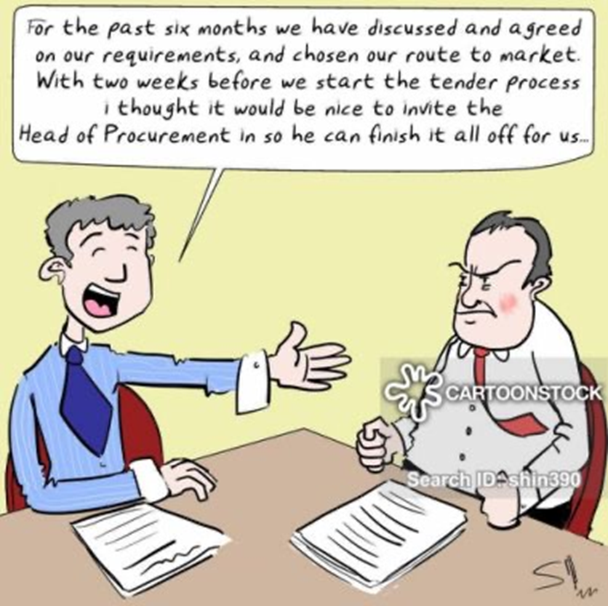
We’re here to help!

Slide 25
Why do we award to the low bidder?
We don’t! Per statute, in determining to whom to award a contract, the District shall consider the following evaluation criteria:
The purchase price;
The reputation of the vendor and the vendor’s goods or services;
The quality of the vendor’s goods or services
The extent to which the goods or services meet the District’s needs;
The vendor’s past relationship with the District;
The impact on the ability of the District to comply with laws and rules relating to historically underutilized businesses;

Slide 26
Evaluation Criteria, cont.
The total long-term cost to the District to acquire the vendor’s goods or services;
for a contract for goods and services, other than goods and services related to telecommunications and information services, building construction and maintenance, or instructional materials, whether the vendor or the vendor’s ultimate parent company or majority owner:
has its principal place of business in this state; or
employs at least 500 persons in this state; and
Any other relevant factor specifically listed in the request for bids or proposals*
*You must be able to justify listing these factors and be able to justify your recommendation based on any of the criteria!

Slide 27
Cooperative Purchasing
The District participates in several cooperative purchasing programs that offer volume discounts for items commonly purchased by a number of public entities. Links to the cooperatives are available here: http://inside.collin.edu/purchasing/general_procedures.html#Cooperative.
Purchases made through a cooperative may satisfy the competitive bid requirement
Cooperative Purchasing Programs
Choice Partners
TIPS
State of Texas & DIR
Omnia Partners
Buyboard
E & I Cooperative
Equalis Group
Collin County Governmental Purchaser’s Forum
Sourcewell
Tarrant County Cooperative Purchasing Network
GSA for Technology, Law Enforcement, Emergency Management, Declared Disaster
National Cooperative Purchasing Alliance (NCPA)
H-GACBuy
Region 10 Education Service Center
Interlocal Agreements with other Community Colleges or other public agencies

Slide 28
Sole Source Purchases
When a product or service can only be provided by one vendor, the department must provide sole source documentation to Purchasing as back-up before the order will be processed or taken to the Board for approval. Sole Source Requisition type should be used when submitting the requisition in Workday and the questionnaire completed.
http://inside.collin.edu/purchasing/general_procedures.html#SoleSourcePurchases

Slide 29
Emergency Purchases
Must be entered into Workday and expedited through the approval path by the requesting department
Emergency expenditures are defined as follows:
To remove hazards
To protect property
To protect people
To alleviate financial loss
To alleviate operation damage
To expedite repairs

Slide 30
Open Purchase Orders
Open purchase should be based on the amount that you spent with the vendor the previous year.
Change orders can be done on Open Purchase Orders, if PO is still open.
Open PO requisition type should be selected and a services line should be used, not goods line.
Open POs cannot be issued to vendors used under a BuyBoard cooperative contract.
The privilege of having open purchase orders is to allow you to get the items you need when you need them and should only be used for:
emergency purposes
many small dollar purchases are anticipated for supplies throughout the year.

Slide 31
Open Purchase Orders, cont.
If it appears that open purchase orders are being abused, then privileges will be suspended.
Receipts must be done on a per purchase basis in Workday. DO NOT RECEIVE ALL!
Include names of authorized staff within the Memo to Supplier field on the requisition.
Home Depot Open POs must include last 4-digits of account number (1439), exact name as on formal ID required, and buyer will request DOB for all new users. Don’t include DOB on the requisition.
Open purchase orders should not be done for purchase orders that are paid the same amount on a monthly basis. Use a Monthly Goods/Services requisition type.

Slide 32
Change Orders
Change orders cannot be done on purchase orders that are at the completely received stage. A new requisition must be entered.
Change order requests will be reviewed on an individual basis. It is the department’s responsibility to make sure that funds for the additional cost are available in their budget.
Change orders increasing the cost at any amount for items that were approved by the Board or for changes that will cause the total purchase to exceed $100,000 will require Board approval.

Slide 33
Invoices That Exceed PO Amount
Accounts Payable will handle invoices that exceed the amount of the PO as follows:
$50/10% or less – Payment is processed with no additional approvals
$50.01/10% or greater increase – Ordering department must process a change order request in Workday and Purchasing will review/approve
A change order must be done if you are adding items to an order.

Slide 34
Anyone who makes a purchase in a manner, which does not follow established purchasing procedures, enters into a private transaction with the vendor, and assumes responsibility for payment. Confirming orders are not acceptable! The requesting department should enter a requisition and call all approvers on the approval path to expedite approval of the requisition. The requesting department should then contact the Purchasing Department to request that the requisition be processed promptly.

Slide 35
Vendor Documentation & Contract Compliance
Always document unsatisfactory performance by a vendor and send to the Buyer in Purchasing to keep on file. You never know when unsatisfactory performance will become habitual, so keep good records in order to support any future debarment of the vendor or actions against the vendor.
It is the departments responsibility to make sure vendor is complying with the terms and conditions of the contract.
Never agree to different terms without consulting Purchasing and putting those changes in writing.

Slide 36
Contract Terms & Fiscal Year Terms
Contract Terms can occur throughout the year
Purchase orders based on contract term should be entered for the remaining months of the fiscal year
Departments should notify AP Supervisor that PO should be left open if goods/services will not be received by the end of the FY
Budget is not rolled so place orders early to avoid having to pay out of the next year’s budget.
Open purchase orders should be done for the FY
Open POs are closed at the end of the FY

Slide 37
Catering – America To Go (ATG)
Collin’s Food Service Department has first right of refusal for all catering.
All catering orders that are not being provided by in-house catering should be placed through a punch-out in Workday (Pizza is an exception)
ATG negotiates contracts with restaurants/caterers and ensures insurance and permits are in place.
When changing an order, please do not contact the restaurant/caterer, contact ATG Customer Service
Be aware of tips/delivery and service fees on quotes
Deposits can be paid for events over $5k
To have restaurants/caterers added, please contact Vivian Bordon at vivian.bordon@americatogo.com and copy Steve Tillman in Purchasing at steve.tillman@collin.edu
Direct all ATG questions to Steve
Customer Care can be reached 24/7 at:
866-ATG-TOGO
customerservice@americatogo.com

Slide 38
Amazon Purchases
Tim Accountius is the internal contact for Amazon order questions
Orders must be submitted through the punchout in Workday and you must set up account with Amazon prior to using punchout
Orders outside 45 day window for delivery
Free two-day shipping on all orders shipped by Amazon, not third party
User account tied to Collin email (must change any personal accounts that use your Collin email)
Amazon orders meeting various restrictions reviewed by Purchasing
Pay attention to ship from information
Select the correct campus to ship to
Some quantity restrictions apply – use Amazon quote function for larger quantities
Amazon does have bulk discounts available
New Single Sign On allows you to view order history, set up wish list and buy again

Slide 39
Staples Purchases
Must include a delivery location on the order
There is a $50 minimum for orders from Staples
Specific categories, such as furniture and technology items are blocked
Contact Steve Tillman at steve.tillman@collin.edu for questions related to purchases from Staples

Slide 40
Tools to Use for Free
Pavilion – Search for suppliers that have cooperative contracts and get quotes.
https://www.withpavilion.com/
Procurated – Search for supplier references and provide references on suppliers.
https://www.procurated.com/
This Photo by Unknown Author is licensed under CC BY-NC

Slide 41
Closing Remarks
Always plan ahead!
Get Purchasing and Facilities involved early!
Document, document, document!
Get it in writing!
Use Workday and the Purchasing Department Intranet site as a resource!
http://inside.collin.edu/purchasing/index.html
Questions???

Slide 42
DISCUSSION & FEEDBACK

