Slide 1
Program Review Data Resources
Service unit
Notes:
Welcome to the guide for data resources for your service unit Program Review. The following information will help provide you with sources to use in identifying trends, and supporting assertions made in your Program Review submission.

Slide 2
Existing Information Sources
Departmental Employees
Departmental Budget, Inventory & Space Utilization
Advisory Committee Meeting Minutes
External Accreditation Submissions
Notes:
Evidence to consider when responding to many of the prompts within the Program Review template can be gathered from sources specific to the program or service unit. Simply reaching out to department members to provide lists of credentials and professional development they have completed may ease the workload of the report preparer.
When considering what your department needs to function, starting with what you already have is a great step. Having the existing departmental budget and lists of facilities and physical inventory utilized by your department will help establish a foundation for you to build on if you can elaborate how those resources will not meet your needs in the future.
When applicable, advisory committee meeting minutes may allow examples of responsiveness to industry requests and a summary of partnership resources.
Programs which are externally accredited have the additional source of using pertinent information they may have already compiled to address prompts that are shared by the accreditors.

Slide 3
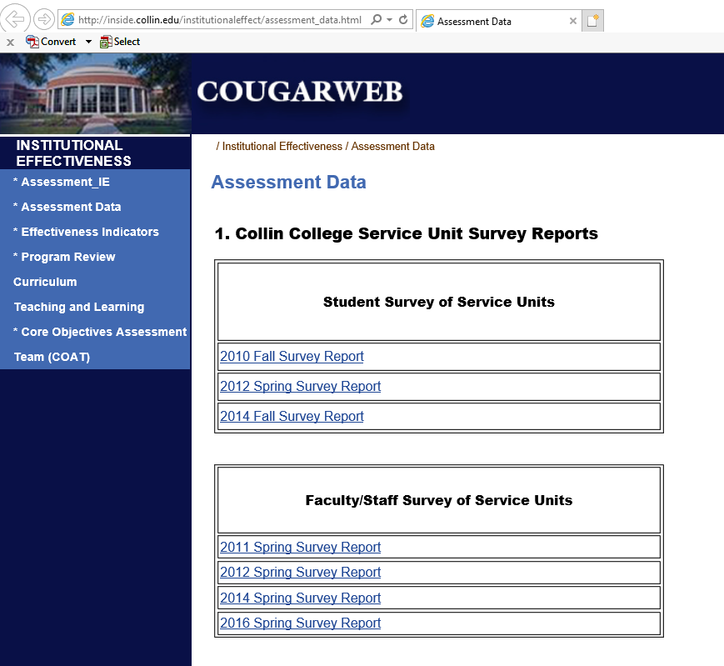
Service Unit Satisfaction Surveys of Students, Faculty and Staff
Within CougarWeb at:
http://inside.collin.edu/institutionaleffect/assessment_data.html
Notes:
Valuable tools for assessing awareness of, and satisfaction with your service unit is the survey conducted roughly every two years. Awareness, usage, hours of availability, procedure user-friendliness, efficiency, timeliness, courtesy, knowledge, and overall satisfaction are topics that are probed in these surveys, as well as respondents’ comments. Surveys are distributed to students, or faculty and staff, depending on the unit’s purpose. If your unit is not represented on the survey and you wish for it to be, please contact Institutional Research. To reach the survey reports, please click on the link while logged into CougarWeb to reach the survey hosting page.

Slide 4
National Community College Benchmark Project (NCCBP)
Form 18 | Student Services: FTE Staff/Student Ratio
Career Services
Counseling & Advising
Recruitment, Admissions, Registration
Financial Aid
Student Activities
Testing & Assessment Services
http://inside.collin.edu/iro/reports.html
Notes:
For a limited number of student services, the National Community College Benchmark Project provides the full-time equivalent staff/student ratio and places it within the percentiles of 250 other participating colleges. For recent and historical entries, click the link to find the NCCBP report on Collin IRO’s intranet page.

Slide 5
National Peer Group
As of 2014, the following colleges were recognized as peers of Collin College. These may be useful for establishing baselines for resource and responsibility comparisons. Please click here to reach an in-depth peer group comparison.
Central New Mexico Community College – Albuquerque, NM
Front Range Community College – Westminster, CO
Hillsborough Community College – Tampa, FL
Long Beach City College – Long Beach, CA
Montgomery, College – Rockville, MD
Oakland Community College – Bloomfield Hills, MI
Pima Community College – Tucson, AZ
Portland Community College – Portland, OR
Saint Louis Community College – St. Louis, MO
Salt Lake Community College – Salt Lake City, UT
San Jacinto Community College – Pasadena, TX
Santa Monica College – Santa Monica, CA
Notes:
Collin’s Institutional Research Office has established a national peer group that is generally aligned with Collin College with respect to cost of living index, student-faculty ratio, and percent of enrollment which is part time. To see more information regarding the national peer group, please click the hyperlinked text on this slide while logged into CougarWeb to reach the intranet page.

Slide 6
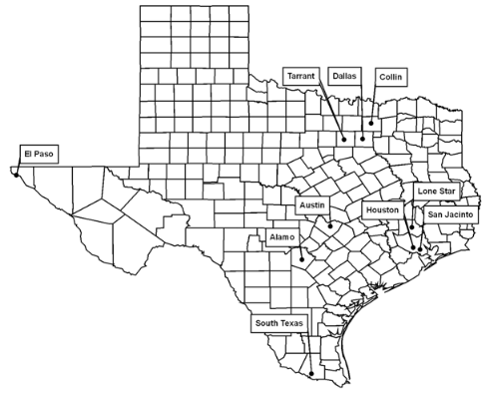
Texas Very Large Community College Peer Group
Alamo Community College District
Austin Community College District
Dallas County Community College District
El Paso Community College District
Houston Community College District
Lone Star College System
San Jacinto Community College District
South Texas College
Tarrant County College District
Notes:
The Texas Very Large Community College Peer Group was established by the Texas Higher Education Coordinating Board. It may serve the same purpose for comparison as the national peer group, but has the benefit of some of the colleges being more accessible for reaching out to than those on the national level. The disadvantage of this peer group is that the colleges are possibly not as closely comparable as those in the national peer group. To see more information regarding this peer group, please click the text on this slide to reach the Texas Higher Education Coordinating Board’s page.

Slide 7
Other Sources
Is the source:
Authoritative or reputable?
Accurate?
Objective?
Current?
Complete in its context?
Notes:
It is important to note that this is not a comprehensive list of all acceptable data sources. There may be other sources that you are familiar with particular to your area. When evaluating a source, exercise the same judgment that you would if you were considering it for a thesis or dissertation. Collin’s Institutional Research Office may also have awareness of other potential material

Slide 8
Thank you!
Notes:
Thank you for using this resource to help in preparation for composing your program review submission. The Program Review Steering Committee hopes for you to receive the greatest benefit from this evaluation of your program or service unit.
Version: 20170830

