Slide 1
Program Review Data Resources
Academic & Workforce programs
Notes:
Welcome to the guide for data resources for your academic or workforce Program Review. The following information will help provide you with sources to use in identifying trends, and supporting assertions made in your Program Review submission.

Slide 2
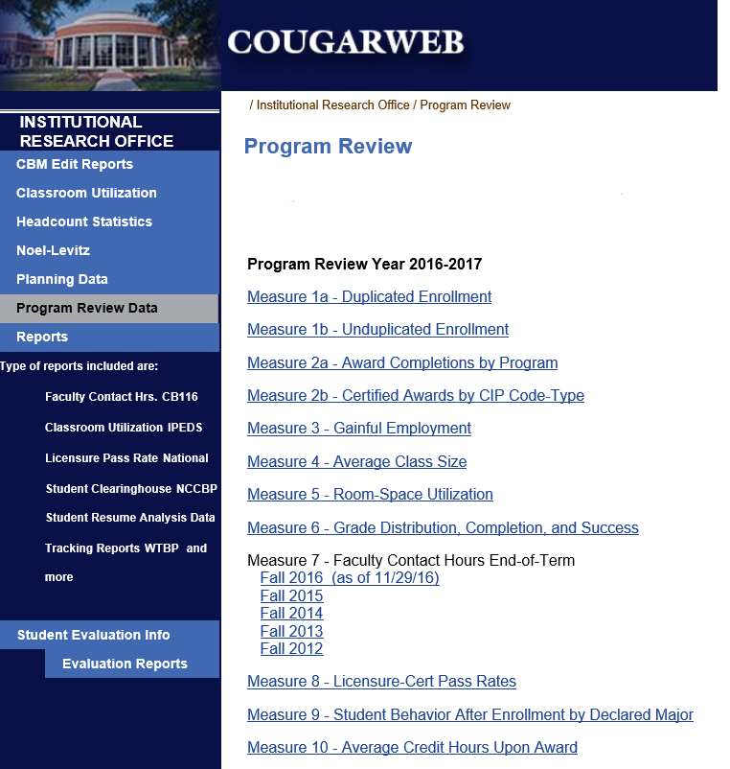
Program Review Reports
Course Enrollment by Term
Award Completions & Credits Upon Award
Gainful Employment
Average Section Size
Room Utilization
Grade Distribution by Course
Faculty Contact Hours
Licensure Pass Rates
Post-award Student Enrollment Behavior
Refreshed annually on approximately October 15th.
http://inside.collin.edu/iro/programreview.html
Notes:
One of the most helpful sources of information is a collection of reports generated each year by Institutional Research to be used as evidence for many of the common questions that are considered by programs undergoing review.
The general report titles here help to give an idea for data usage planning, though it is important to note that reports with the most recent academic year data may not be available until approximately October 15th.
To find the reports, please click the link at the bottom of this slide. On the following CougarWeb page, clicking a measure’s link will take you either to a document containing the information, or to a page allowing you to select the specific program in which you are interested. Alternately, this page may be reached by logging into CougarWeb and clicking the “My Workplace” tab near the top of the browser window. On the following page, find the Organizational Effectiveness pane on the left side of the page, and then find Institutional Research under the Institutional Research Office subsection. Once on the Institutional Research page, look to the left-hand navigation bar until you find Program Review Data.

Slide 3
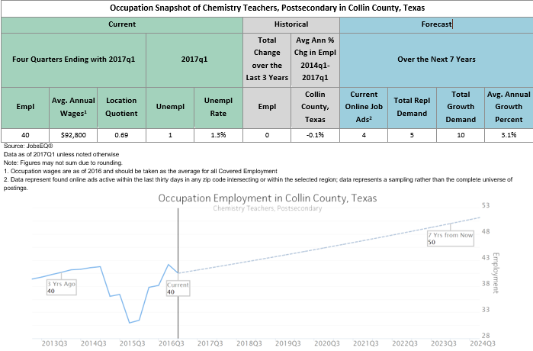
Career & Job Information
Career Coach https://collin.emsicareercoach.com/
JobsEQ
Notes:
When responding to being asked about the program’s relationship to market demand, a solid response may incorporate information about employment trends, wages, and attributes associated with occupations in the field.
Career Coach is a solution available to anyone, and provides wage information, a short term estimate on job growth or decline for the region around Collin County. To reach Collin’s Career Coach account, please use the URL in your browser or click on the link.
JobsEQ is a tool with more in-depth data on education, industries, occupations. This includes some of the information available from Career Coach, but also includes more detailed statistics, a wider definable region, and a more comprehensive package. Using CIP codes or Standard Occupation Classification codes, a plethora of information can be gathered through reports or more concise snapshots. Because Collin has only a limited number of JobsEQ licenses, access is not available to all employees. Please contact Institutional Research Office at least ten working days in advance so that they may provide the information to you with sufficient time for you to use it.

Slide 4
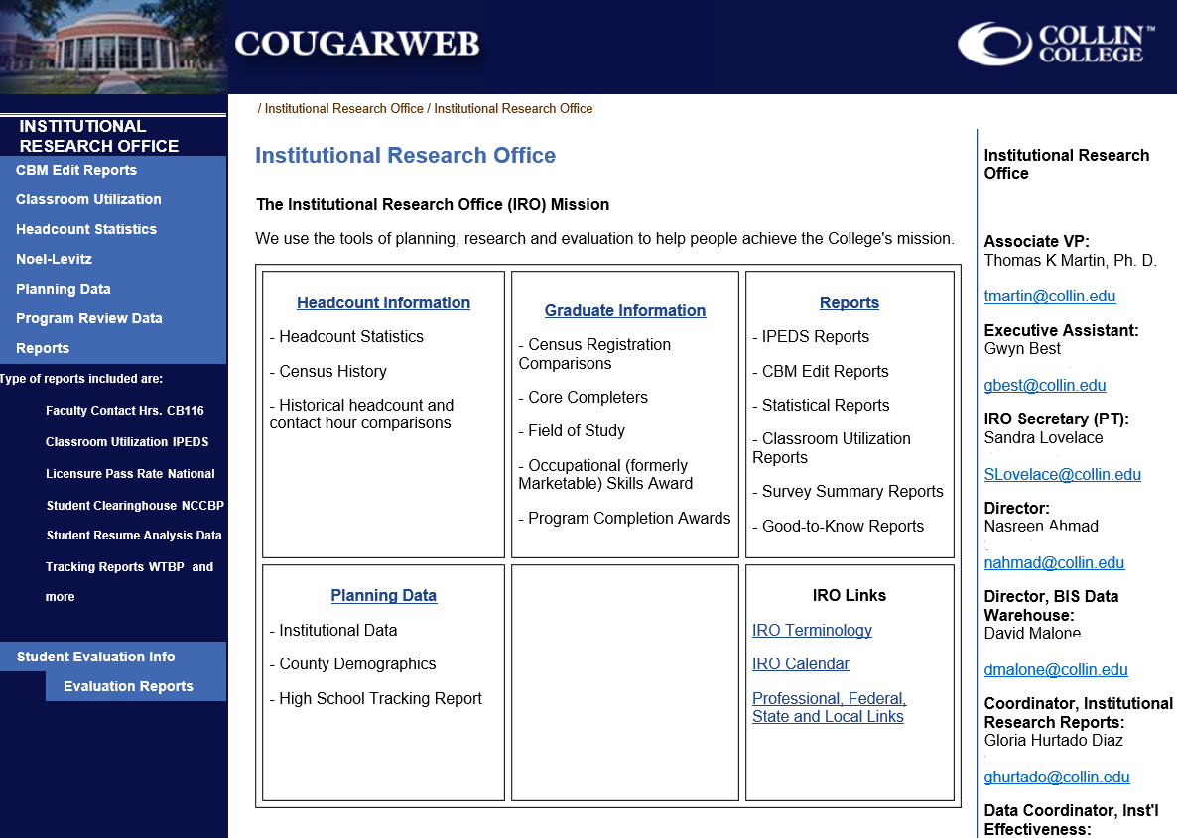
Other Institutional Research Data http://inside.collin.edu/iro/
Notes:
The Institutional Research Office has generated a large number of reports and collected a large amount of data. While it may be broken down by academic year instead of by term, or by term instead of month, there is a good chance that data has been collected in a way that will provide answers to your question.
To view some of the reports, feel free to explore Institutional Research’s intranet page by going to the URL or clicking either it or the image while logged into CougarWeb. If assistance from an analyst is desired, contact information is available on the right-hand column of that page.

Slide 5
Existing Information Sources
Departmental Employees
Departmental Budget, Inventory & Space Utilization
Advisory Committee Meeting Minutes
External Accreditation Submissions
Notes:
Evidence to consider when responding to many of the prompts within the Program Review template can be gathered from sources specific to the program or service unit. Simply reaching out to department members to provide lists of credentials and professional development they have completed may ease the workload of the report preparer.
When considering what your department needs to function, starting with what you already have is a great step. Having the existing departmental budget and lists of facilities and physical inventory utilized by your department will help establish a foundation for you to build on if you can elaborate how those resources will not meet your needs in the future.
When applicable, advisory committee meeting minutes may allow examples of responsiveness to industry requests and a summary of partnership resources.
Programs which are externally accredited have the additional source of using pertinent information they may have already compiled to address prompts that are shared by the accreditors.

Slide 6
Program Satisfaction Surveys
Employer Satisfaction Surveys
Program-initiated Student Satisfaction Surveys
Notes:
Surveys are valuable tools for assessing satisfaction with your program. If your program conducts employer or student satisfaction surveys, you may wish to reference them in your submission. These may be in response to external accreditation requirements, or implemented as a result of a program initiative. Whatever the flavor, surveys can go a long way in providing feedback on programs’ performance or direction.

Slide 7
National Peer Group
As of 2014, the following colleges were recognized as peers of Collin College. These may be useful for establishing baselines for resource and responsibility comparisons. Please click here to reach an in-depth peer group comparison.
Central New Mexico Community College – Albuquerque, NM
Front Range Community College – Westminster, CO
Hillsborough Community College – Tampa, FL
Long Beach City College – Long Beach, CA
Montgomery, College – Rockville, MD
Oakland Community College – Bloomfield Hills, MI
Pima Community College – Tucson, AZ
Portland Community College – Portland, OR
Saint Louis Community College – St. Louis, MO
Salt Lake Community College – Salt Lake City, UT
San Jacinto Community College – Pasadena, TX
Santa Monica College – Santa Monica, CA
Notes:
Collin’s Institutional Research Office has established a national peer group that is generally aligned with Collin College with respect to cost of living index, student-faculty ratio, and percent of enrollment which is part time. To see more information regarding the national peer group, please click the hyperlinked text on this slide while logged into CougarWeb to reach the intranet page.

Slide 8
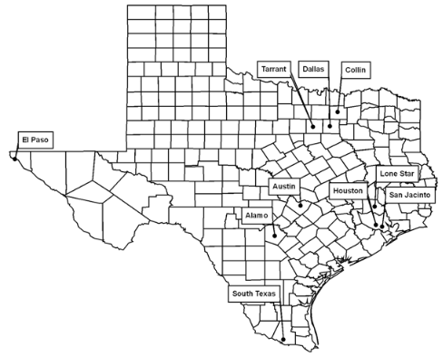
Texas Very Large Community College Peer Group
Alamo Community College District
Austin Community College District
Dallas County Community College District
El Paso Community College District
Houston Community College District
Lone Star College System
San Jacinto Community College District
South Texas College
Tarrant County College District
Notes:
The Texas Very Large Community College Peer Group was established by the Texas Higher Education Coordinating Board. It may serve the same purpose for comparison as the national peer group, but has the benefit of some of the colleges being more accessible for reaching out to than those on the national level. The disadvantage of this peer group is that the colleges are possibly not as closely comparable as those in the national peer group. To see more information regarding this peer group, please click the text on this slide to reach the Texas Higher Education Coordinating Board’s page.

Slide 9
Other Sources
Is the source:
Authoritative or reputable?
Accurate?
Objective?
Current?
Complete in its context?
Notes:
It is important to note that this is not a comprehensive list of all acceptable data sources. There may be other sources that you are familiar with particular to your area. When evaluating a source, exercise the same judgment that you would if you were considering it for a thesis or dissertation. Collin’s Institutional Research Office may also have awareness of other potential material

Slide 10
Thank you!
Notes:
Thank you for using this resource to help in preparation for composing your program review submission. The Program Review Steering Committee hopes for you to receive the greatest benefit from this evaluation of your program or service unit.
Version: 20170830

