Slide 1

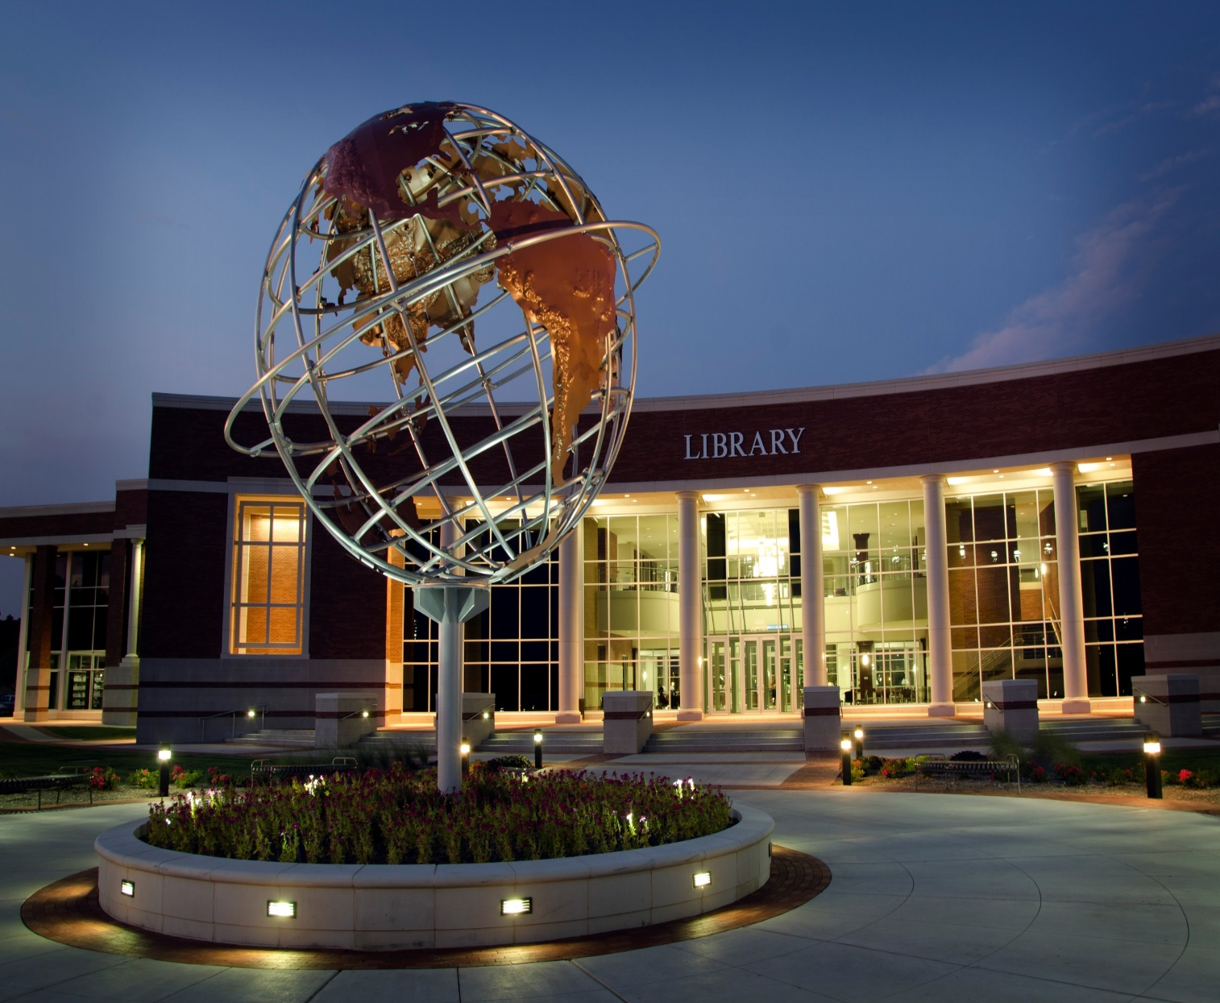
Program Review
Institutional Research Office - Institutional Effectiveness
Noor Abdulaziz, Ph.D.

Slide 2



Agenda
Purpose & Objectives
Purpose & Objectives
01
The purpose and objectives of the program review will be presented and discussed.
Program Review Report
2
02
Process & Timeline
The program review process and timeline will be introduced and discussed.
Process & Timeline
Program Review Report
03
The program self-evaluation criteria will be presented and discussed
Program Review Report Assessment
Program Review Report Assessment
04
How the Program Review Steering Committee assesses the program review report?
4
Monitoring & Evaluation

Slide 3

Program Review
Purpose & Objectives
A process that evaluates the status, effectiveness, and progress of academic programs and service units which helps identify the future directions, needs, and priorities of these programs.
Data sharing Consortia

Slide 4
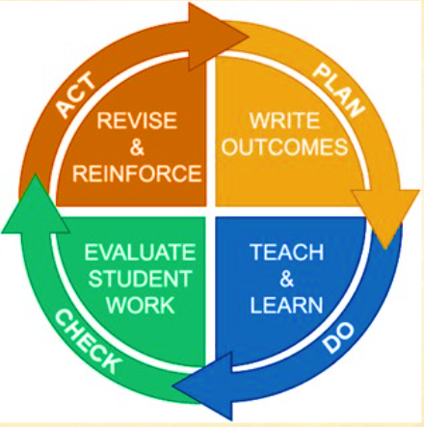
Program Review Purpose
Purpose & Objectives
Guide the improvement of academic programs and service units continuously while ensuring the program needs are met, and the essential quality standards are high.

Slide 5
Program Review Goals
Purpose & Objectives
To improve program and service unit’s quality in alignment with the college’s mission; to meet accreditation standards and address institutional resource needs and demands.
To help instructional programs and service units self-evaluate their performance within a framework that consists of past development and plans for the future.
To provide the program or service unit with an impartial study of and response to the work presented in the Program Review Report by informed colleagues outside the program.
Quality Improvement
1
Self-evaluation of the Programs
2
Program Review Report Assessment
3
Data sharing Consortia

Slide 6
Program Review Schedule
Process & Timeline
Years 1 & 3: Implement the action plan of the CIP and collect data.
Years 2 & 4: Analyze data and findings from the previous year, update action plan, and send to IRO.
Year 5: Write Program Review Report for the past 5 years; Write Continuous Improvement Plan (CIP) and create a new Action Plan.

Slide 7
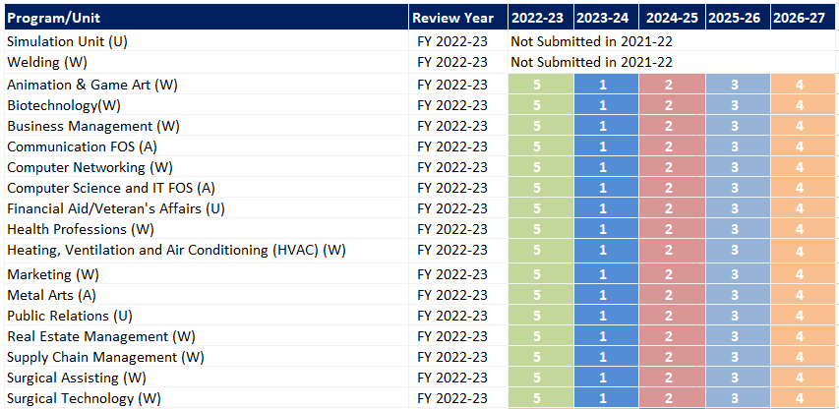
Program Review Schedule
Process & Timeline
Year 5: Write Program Review Report for the past 5 years; Write Continuous Improvement Plan (CIP) and create a new Action Plan.
http://inside.collin.edu/institutionaleffect/program_review/Program%20Review%20Schedule%20By%20Year%2008092022.pdf

Slide 8
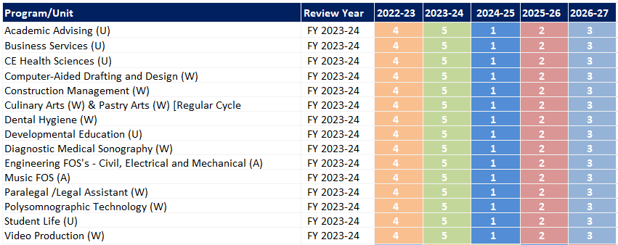
Program Review Schedule
Process & Timeline
Year 4: Analyze data and findings from the previous year, update action plan, and send to IRO.
http://inside.collin.edu/institutionaleffect/program_review/Program%20Review%20Schedule%20By%20Year%2008092022.pdf

Slide 9
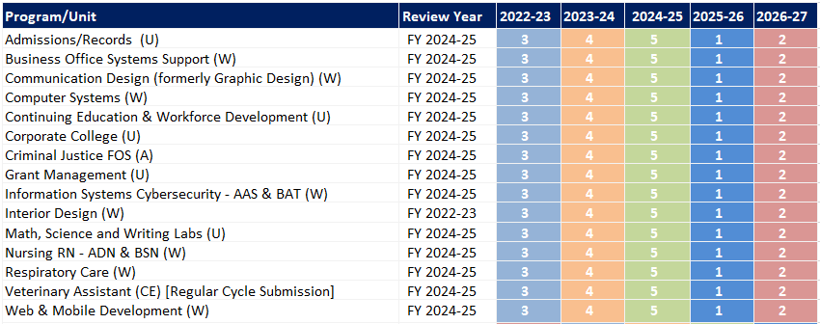
Program Review Schedule
Process & Timeline
Year 3: Implement the action plan of the CIP and collect data.
http://inside.collin.edu/institutionaleffect/program_review/Program%20Review%20Schedule%20By%20Year%2008092022.pdf

Slide 10
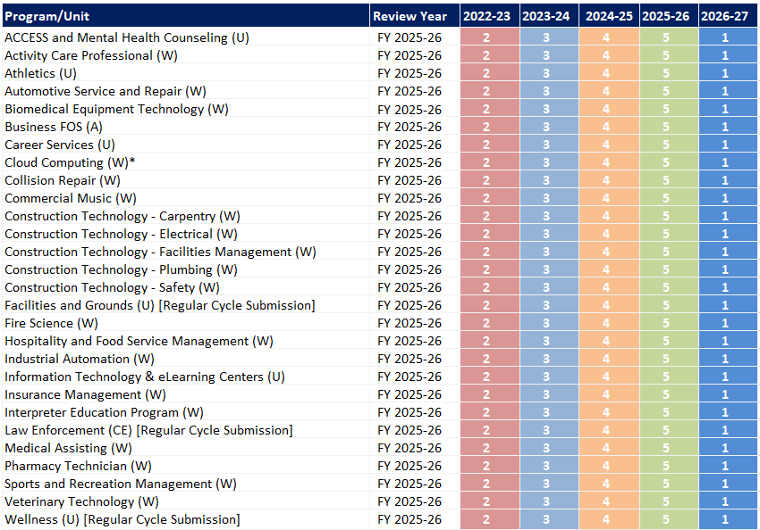
Program Review Schedule
Process & Timeline
Year 2: Analyze data and findings from the previous year, update action plan, and send to IRO.
http://inside.collin.edu/institutionaleffect/program_review/Program%20Review%20Schedule%20By%20Year%2008092022.pdf

Slide 11
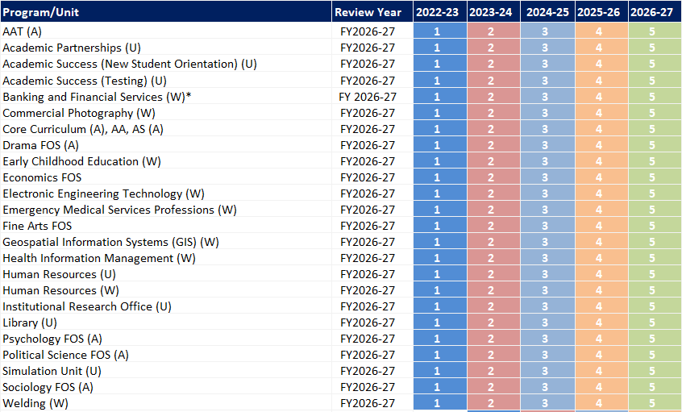
Program Review Schedule
Process & Timeline
Year 1: Implement the action plan of the CIP and collect data.
http://inside.collin.edu/institutionaleffect/program_review/Program%20Review%20Schedule%20By%20Year%2008092022.pdf

Slide 12
Program Review Timeline
Process & Timeline
May
Phase I: Dean to Assemble Program Review Team
The team should consist of a Discipline Lead. The lead author can be the Discipline Lead or full-time faculty and an additional 2-3 faculty. This can be mixed with full-time and part-time.
Jun. – Aug.
Continuous Improvement Plan (CIP)
Dean works with Program Review Team and all Discipline Lead on CIP. Arrange CIP training with the IRO representative. CIP data should be collected and analyzed and ready for submission before Jan. 30th.
August
Phase II: Program Review Planning
IRO representatives to meet with the Program Review Team and provide training as needed.
Be familiar with resources (IRO data, Assessment Data, Advisory Committee reports, etc.).
Sep. & Oct.
Phase III: Program Self-evaluation
Program Review Team meets weekly or bi-weekly to discuss the progress of the self-evaluation.
All Program Review Team members should attend the Program Review Orientation in October.
Review and finalize data collected in years 1 to 4.

Slide 13
Program Review Timeline
Process & Timeline
Nov. - Dec.
Phase IV: Program Review Report
Program Review Team work on the self-evaluation and share status weekly or bi-weekly.
Dean should have feedback ready for faculty when they report back in January.
Jan.
Phase V: Dean’s Revision of the Program Review Report
Meet with the Program Review Team and finalize any edits after the Jan. 15th submission.
Finalize and upload all attachments and appendices needed for support by Jan. 25th.
Program Review Reports and CIPs due to the IRO on or before Jan. 30th.
Apr.
Phase VI: PRSC Assessment of the Program Review Report
PRSC completes reviews.
The PRSC chair will notify Deans of the status of the Program Review Reports.
Meet with the reviewers to go over the feedback.
Program Review End-of-Cycle Report and Program Review Reports submitted to leadership.
Aug.
Phase VII: Final Program Review Report
Program Review Reports are posted to the Institutional Effectiveness intranet site on 08/01.

Slide 14
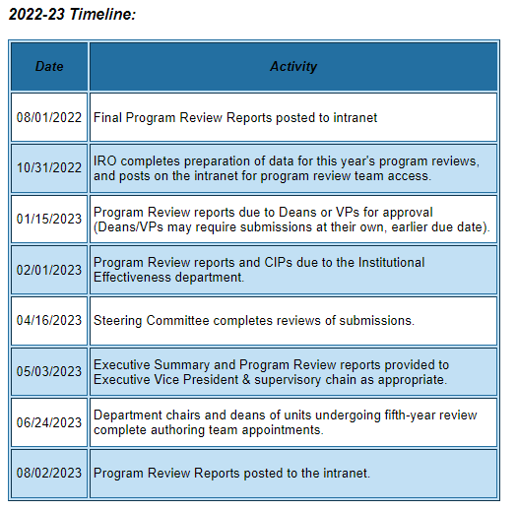
Program Review Schedule
Process & Timeline
http://inside.collin.edu/institutionaleffect/Program_Review_Process.html

Slide 15
Program Self-evaluation – Evidence Guidelines
Program Review Report
Data Sources
The evidence may come from various data sources including professional accreditation reviews, THECB, Texas Workforce Commission’s CREWS, Collin’s Institutional Research Office (IRO), National Student Clearinghouse, IPEDS, JobsEQ, and may be quantitative and/or qualitative.
The use of additional reliable and valid data sources of which you are aware is encouraged.
*If you are unfamiliar with any of these information sources, contact the Institutional Research Office at: effectiveness@collin.edu or nabdulaziz@collin.edu.

Slide 16
Program Self-evaluation – Evidence Guidelines
Program Review Report
Collin’s Institutional Research Office (IRO), The Program Review Portal
Programs should be aware of and respond to the data and data-driven analyses provided periodically (last week of October) through IRO.
The program review supporting data provided by IRO include Labor Market Report, Unduplicated Enrollment, Duplicated Enrollment, Average Section Size, Grade Distribution, Faculty Contact Hours, Licensure Pass Rate Report, and Completion Report.
Indirect assessment involves measuring student perceptions of learning, course evaluations, and student and faculty satisfaction surveys.
Can be found at Program Review Data Resources (collin.edu).
Any further questions regarding Program Review should be addressed to the Institutional Research Office at effectiveness@collin.edu or nabdulaziz@collin.edu.

Slide 17
Program Review Self-evaluation Template
Program Review Report
Academic Programs:
What does the academic program do?
Program relationship to the college mission and strategic plan.
Program relationship to student demand.
Marketable skills students should have after completing the program.
How effective is the program’s curriculum?
How well does the program communicate?
How well are partnership resources built & leveraged?
Are the faculty supported with professional development?
Does the program have adequate facilities, equipment, and financial resources?
How have past Continuous Improvement Plans contributed to the success?
How will the program evaluate its success?
Continuous Improvement Plan (CIP)

Slide 18
Program Review Self-evaluation Template
Program Review Report
Workforce Programs:
What does the workforce program do?
Program relationship to the college mission and strategic plan.
Program relationship to student demand.
Program relationship to market demand.
How effective is the program’s curriculum?
How well does the program communicate?
How well are partnership resources built & leveraged?
Are the faculty supported with professional development?
Does the program have adequate facilities, equipment, and financial resources?
How have past Continuous Improvement Plans contributed to the success?
How will the program evaluate its success?
Continuous Improvement Plan (CIP)

Slide 19
Program Review Self-evaluation Template
Program Review Report
Continuing Education Programs:
What does the workforce program do?
Program relationship to the college mission and strategic plan.
Program relationship to student demand.
Program relationship to market demand.
How effective is the program’s curriculum?
How well does the program communicate?
How well are partnership resources built & leveraged?
Are the faculty supported with professional development?
Does the program have adequate facilities, equipment, and financial resources?
How have past Continuous Improvement Plans contributed to the success?
How will the program evaluate its success?
Continuous Improvement Plan (CIP)

Slide 20
Program Review Self-evaluation Template
Program Review Report
Service Units:
What Does the Unit Do?
Unit's Relationship to the College Mission and Strategic Plan.
Why Are Unit Processes Done?
How Does the Unit Impact Student Outcomes?
How Effectively Does the Unit Communicate?
Are Partnerships Developed and Leveraged?
Are Staff Supported with Professional Development Opportunities?
Does the unit have adequate facilities, equipment, and financial resources?
How have past Continuous Improvement Plans contributed to the success?
How will the unit evaluate its success?
Continuous Improvement Plan (CIP) Tables.

Slide 21
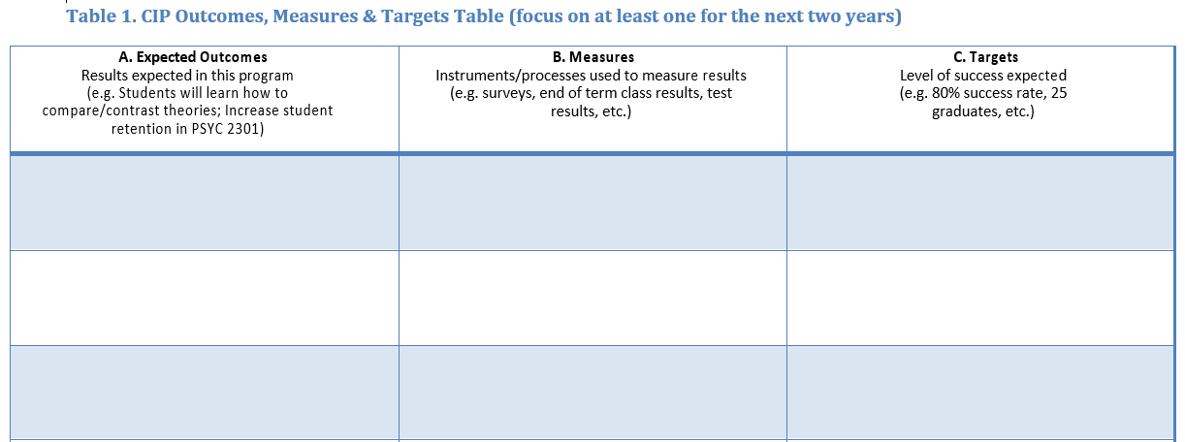
Program Review Self-evaluation Template
Program Review Report
12. Complete the Continuous Improvement Plan (CIP)
Within the context of the information collected in this review process and any other relevant data, identify program priorities for the next two years and focus on these priorities to formulate your CIP. You may also add short-term administrative, technological, assessment, resource, or professional development outcomes as needed.

Slide 22
Assessing the Program Review Report
Program Review Report Assessment
The Program Review Steering Committee (PRSC) is a standing committee of the College. The committee is responsible to:
  Foster ongoing two-way communication between instructional programs, service units, and leadership.
  Support developing a clear rating system and guidelines linked directly to the SACSCOC standards.
  Actively participate in the Program Review process in an advisory capacity.
  Evaluate program review reports.
  Helps to articulate and support training needs.
  Maintain a rating system that indicates the overall quality of each Program Review Report based upon documented criteria.

Slide 23
Program Review Report Assessment
Program Review Report Assessment

Slide 24
Questions!

