Slide 1
Catalog Webpage Style Guides
Maintain accurate and up-to-date information to support students, staff, and faculty in the academic planning process
Provide current data and trends to engage students in your program
Outline Marketable Skills
Verify and improve consistency with the printed catalog

Slide 2
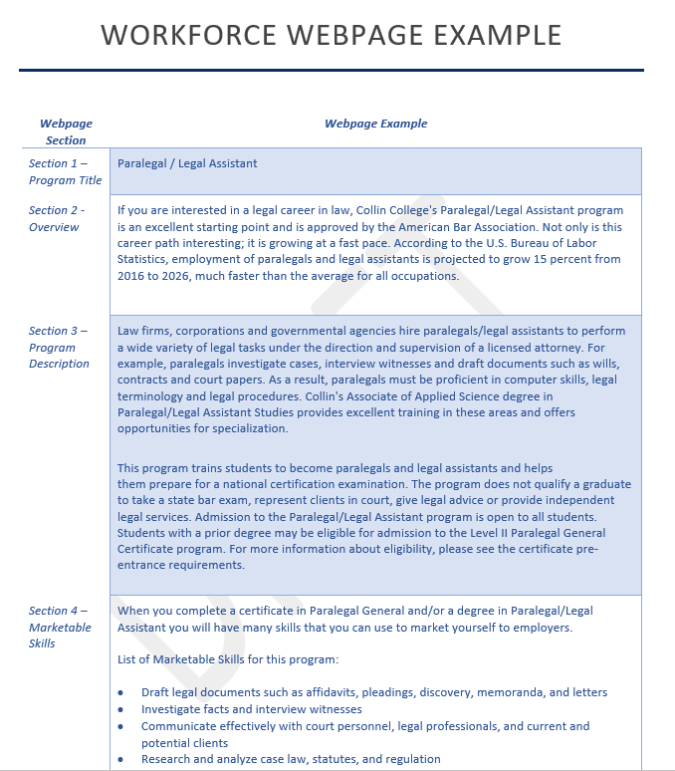
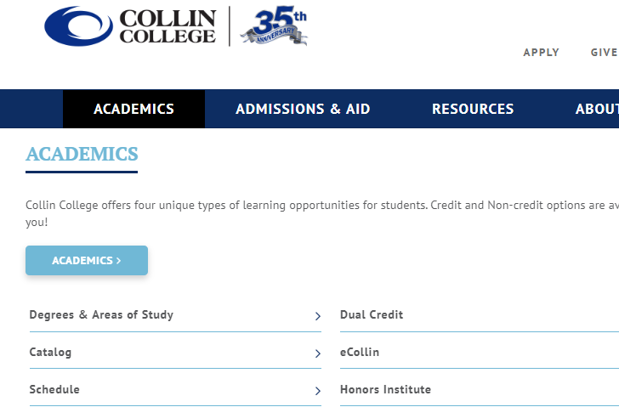
Catalog Webpage Access & Template
Notes:
Online catalog page location (not department page)
Cover each template section as provided in the printed handout
Highlight the addition of marketable skills and where to include curriculum outlines (not on department site)
Review full example at end of printout

Slide 3
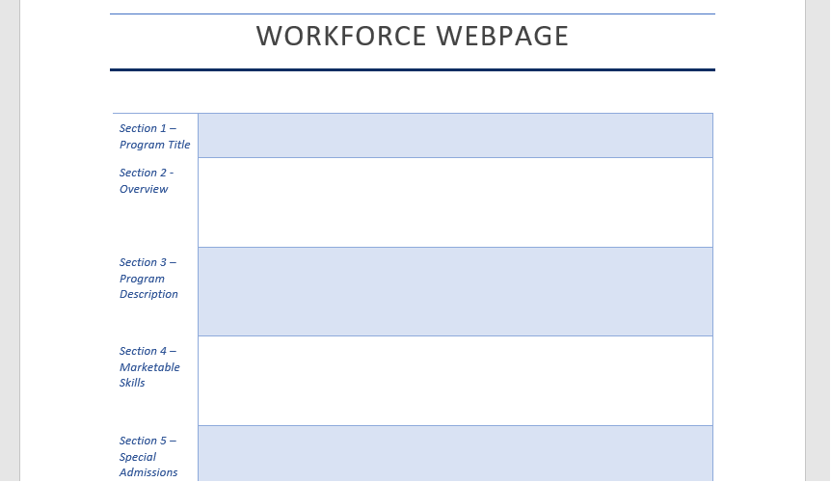
Catalog and Webpage Resources
Submit revisions to lcastleman@collin.edu. The deadline to submit curriculum and/or content revisions to the Curriculum Office is March 1, 2020.
Notes:
How to access resources and templates in CougarWeb
Submission deadline and process
Clarification: this is not referring to any curriculum revisions, those will continue to be reviewed by CAB
Share Workshop Flyer
(add new templates and workshop flyer to page)

